Slide 1



Digital Filtering
Joao Firmino, Yarden Segal

Slide 2
Images as 2D Array
0
0
0
0
0
1,1
2,1
3,1
4,1
5,1
0
0
0
0
0
1,2
2,2
3,2
4,2
5,2
=
0
0
255
0
0
1,3
2,3
3,3
4,3
5,3
0
0
0
0
0
1,4
2,4
3,4
4,4
5,4
0
0
0
0
0
1,5
2,5
3,5
4,5
5,5
5 x 5 pixels
8-bit image
Pixel values
Pixel coordinates
(xn,yn)
Notes:
Glossed over it last time

Slide 3
Basic Image Operations
Thresholding
Logical Operations
Convolution & Filtering
Notes:
Image segmentation

Slide 4
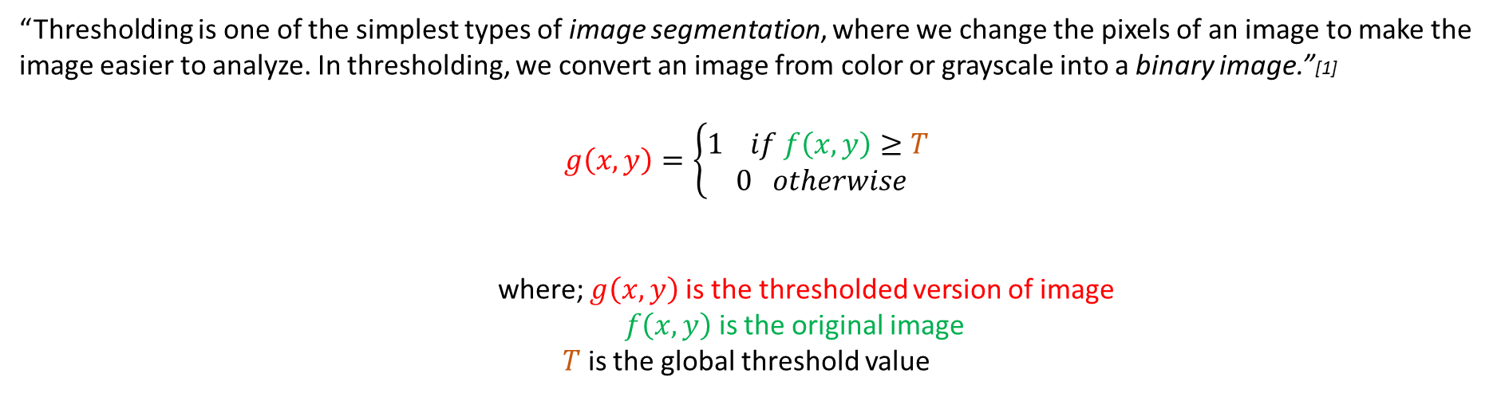
Thresholding
“Thresholding is one of the simplest types of image segmentation, where we change the pixels of an image to make the image easier to analyze. In thresholding, we convert an image from color or grayscale into a binary image.”[1]
$$g\left(x,y\right)=\left\{\begin{aligned}1 if f\left(x,y\right)≥T \\ 0 otherwise\end{aligned}\right.$$
where; $g\left(x,y\right)$is the thresholded version of image
$f\left(x,y\right)$is the original image
$T$ is the global threshold value
Notes:
Image segmentation – as the name suggests is a process where you partition an image into different image segments
Homework

Slide 5
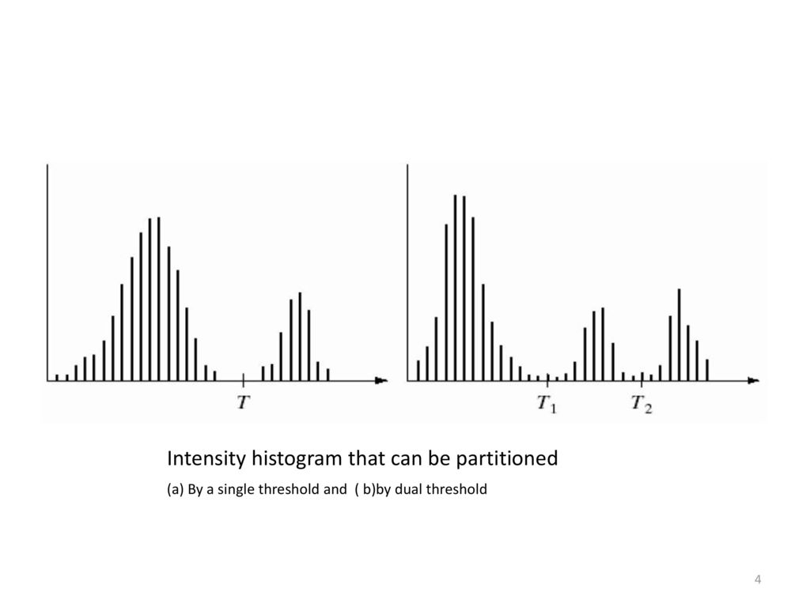
Thresholding
Single Threshold
Dual Threshold
[2]
Notes:
Histogram, Entropy, Clustering, Spatial, Attribute, methods etc

Slide 6
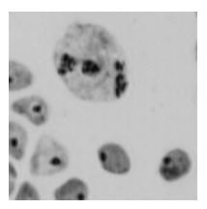
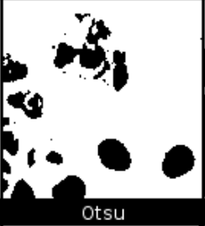
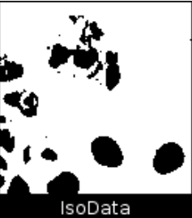
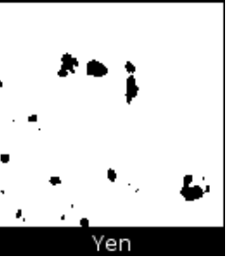
Thresholding Methods
Otsu’s Method
Searches for the threshold that minimizes the intra-class variance, defined as a weighted sum of the variances of two classes (background and foreground)[3]
IsoData Method
Searches for thresholds intensities that separate the image into two groups of pixels, where the threshold intensity is midway between the mean intensities of these groups[4]
Yen’s Thresholding Method
Multilevel Thresholding based on the
maximum correlation criterion[5]
Original image
[11]

Slide 7

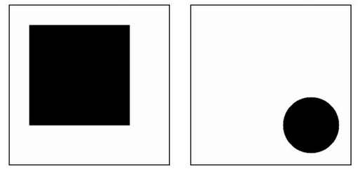



Logical Operators
NOT (!)
AND (&)
OR (|)
XOR (^)
x | F
1 | 0
0 | 1
x | y | F
0 | 0 | 0
0 | 1 | 0
1 | 0 | 0
1 | 1 | 1
x | y | F
0 | 0 | 0
0 | 1 | 1
1 | 0 | 1
1 | 1 | 1
x | y | F
0 | 0 | 0
0 | 1 | 1
1 | 0 | 1
1 | 1 | 0
Original images
x
y
!x
!y
x & y
x | y
x ^ y
[6]

Slide 8
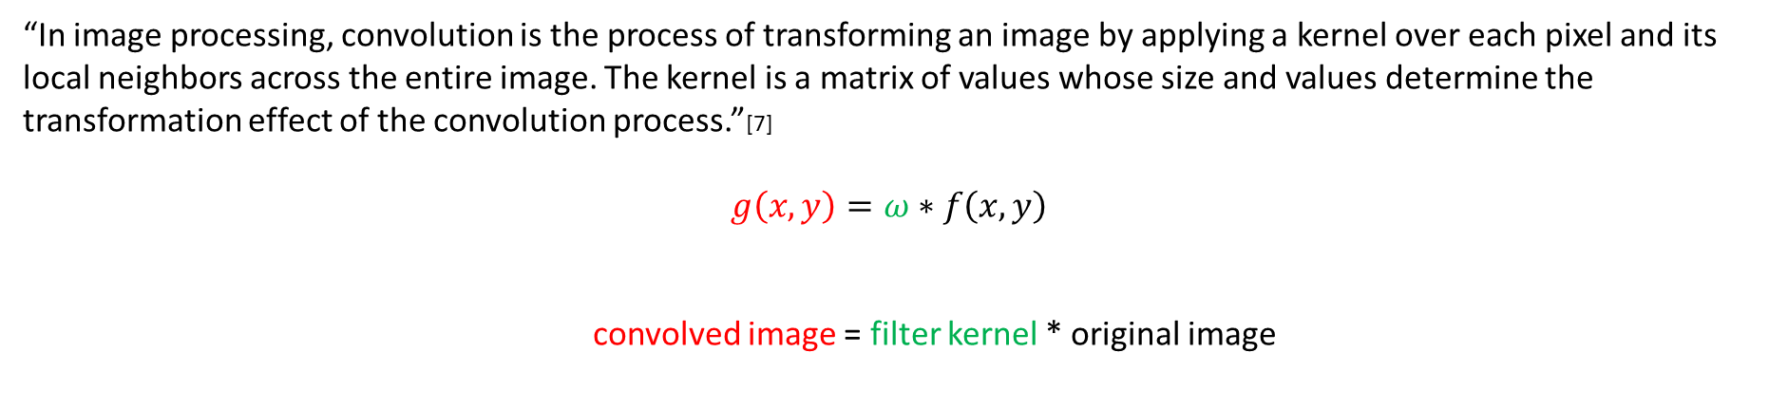
Convolution
“In image processing, convolution is the process of transforming an image by applying a kernel over each pixel and its local neighbors across the entire image. The kernel is a matrix of values whose size and values determine the transformation effect of the convolution process.”[7]
$$g\left(x,y\right)=ω∗f\left(x,y\right)$$
convolved image = filter kernel * original image
Notes:
Emph process of filter
Joao will send ref

Slide 9
Convolution
0
0
0
0
0
0
0
0
0
0
0
0
0
0
0
0
0
0
0
0
The Convolution Process involves 3 steps:
Place the Kernel Matrix over each pixel of the image (ensuring that the full Kernel is within the image), multiply each value of the Kernel with the corresponding pixel
Then, sum the resulting multiplied values and return the resulting value as the new value of the center pixel.
This process is repeated across the entire image.
0
0
255
0
0
0
0
255
0
0
0
0
0
0
0
0
0
0
0
0
0
0
0
0
0
0
0
0
0
0
Original image
0*0+0*0+0*0+0*0+1*0+0*0+0*255+0*0+0*0
0*0+0*0+0*0+0*0+1*255+0*0+0*0+0*0+0*0
0*0+0*0+0*0+0*0+1*0+0*255+0*0+0*0+0*0
0*0+0*0+0*0+0*0+1*0+0*0+0*0+0*255+0*0
0*0+0*0+0*0+0*0+1*0+0*0+0*0+0*0+0*255
0 0 0
0 1 0
0 0 0
0
0
0
0
255
0
0
0
0
Identity kernel
Filtered image

Slide 10
Convolution
0
0
0
0
0
0
0
0
0
0
0
0
0
0
0
0
0
0
0
0
0
0
255
0
0
0
0
255
0
0
0
0
0
0
0
0
0
0
0
0
What about the edge pixels of the image?
In FIJI, we assume that the absent pixels analyzed by the kernel have the value of 0.
In Python, it’s function dependent.
Therefore, the original image remains unchanged when applying the identity kernel.
0
0
0
0
0
0
0
0
0
0
Original image
0 0 0
0 1 0
0 0 0
Identity kernel
Filtered image

Slide 11
Other kernels
0
0
0
0
0
0
0
0
0
0
0
0
255
0
0
0
0
0
0
0
Mean filtering is a simple, intuitive and easy to implement method of smoothing images, i.e. reducing the amount of intensity variation between one pixel and the next. It is often used to reduce noise in images.
1/9 1/9 1/9
1/9 1/9 1/9
1/9 1/9 1/9
0
0
0
0
0
Original image
0
0
0
0
0
0
28
28
28
0
[7]
Mean kernel
0
28
28
28
0
0
28
28
28
0
0
0
0
0
0
Filtered image

Slide 12
Other kernels
0
0
0
0
0
0
255
0
0
0
0
0
0
0
0
0
0
0
0
0
1/9 1/9 1/9
1/9 1/9 1/9
1/9 1/9 1/9
0
0
0
0
0
Original image
28
28
28
0
0
28
28
28
0
0
Mean kernel
28
28
28
0
0
[7]
0
0
0
0
0
0
0
0
0
0
Filtered image

Slide 13
Other kernels
0
0
0
0
0
0
0
0
0
0
0
0
255
0
0
0
0
0
0
0
The median filter is normally used to reduce noise in an image, somewhat like the mean filter. However, it often does a better job of preserving useful detail in the image than the mean filter. [7]
0
0
0
0
0
Original image
0
0
0
0
0
0
0
0
0
0
Median kernel
0
0
0
0
0
0
0
0
0
0
0
0
0
0
0
Filtered image

Slide 14
Other kernels
0
0
0
0
0
0
0
0
0
0
0
0
255
0
0
0
0
0
0
0
The Gaussian smoothing operator is a 2-D convolution operator that is used to “blur” images and remove detail and noise. In this sense it is similar to the mean filter, but it uses a different kernel that represents the shape of a Gaussian (“bell-shaped”) curve. [7]
1 2 1
2 4 2
1 2 1
0
0
0
0
0
Original image
1
16
0
0
0
0
0
0
15
25
15
0
Gaussian blur 3*3
(approximation)
0
25
41
25
0
0
15
25
15
0
0
0
0
0
0
Filtered image

Slide 15

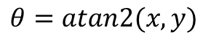
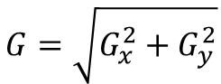

Other kernels
- 1 0 1
- 2 0 2
- 1 0 1
$G_{x}$ =
The Sobel Filter operator is 2-D convolution operator that is used for edge detection in image processing. The approach works through calculation of the gradient of the image intensity at every pixel within the image. [8]
1 2 1
0 0 0
- 1 -2 1
Gradient:
Angle:
$$G=\sqrt{G_{x}^{2}+G_{y}^{2}}$$
$G_{y}$ =
$$θ=atan2(x,y)$$
Sobel Filter 3*3
(approximation)

Slide 16
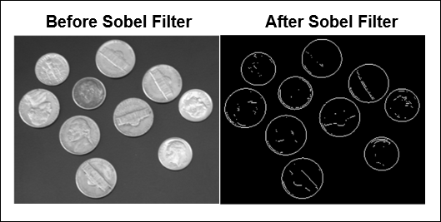

Other kernels
0
0
0
0
0
0
0
0
0
0
255
255
255
255
255
255
255
255
255
255
1 2 1
0 0 0
- 1 -2 1
255
255
255
255
255
Original image
Original image
$G_{y}$ =
0
0
0
0
0
0
0
0
0
0
255
255
255
255
255
Horizontal Sobel Filter
255
255
255
255
255
0
0
0
0
0
Filtered image
Filtered image
[9]

Slide 17
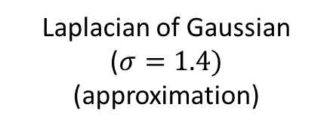
Other kernels
0
0
0
0
0
0
0
0
0
0
The Laplacian is a 2-D isotropic measure of the 2nd spatial derivative of an image. The Laplacian of an image highlights regions of rapid intensity change and is therefore often used for edge detection (see zero crossing edge detectors). The Laplacian is often applied to an image that has first been smoothed with something approximating a Gaussian smoothing filter in order to reduce its sensitivity to noise, and hence the two variants will be described together here.
0 | 1 | 1 | 2 | 2 | 2 | 1 | 1 | 0
1 | 2 | 4 | 5 | 5 | 5 | 4 | 2 | 1
1 | 4 | 5 | 3 | 0 | 3 | 5 | 4 | 1
2 | 5 | 3 | -12 | -24 | -12 | 3 | 5 | 2
2 | 5 | 0 | -24 | -40 | -24 | 0 | 5 | 2
2 | 5 | 3 | -12 | -24 | -12 | 3 | 5 | 2
1 | 4 | 5 | 3 | 0 | 3 | 5 | 4 | 1
1 | 2 | 4 | 5 | 5 | 5 | 4 | 2 | 1
0 | 1 | 1 | 2 | 2 | 2 | 1 | 1 | 0
0
0
255
0
0
0
0
0
0
0
0
0
0
0
0
Original image
0
0
0
0
0
0
8
65
8
0
Laplacian of Gaussian
($σ=1.4)$
(approximation)
0
65
168
65
0
0
8
65
8
0
0
0
0
0
0
[7]
Filtered image
Notes:
This means that in areas where the image has a constant intensity (i.e. where the intensity gradient is zero), the LoG response will be zero. In the vicinity of a change in intensity, however, the LoG response will be positive on the darker side, and negative on the lighter side

Slide 18
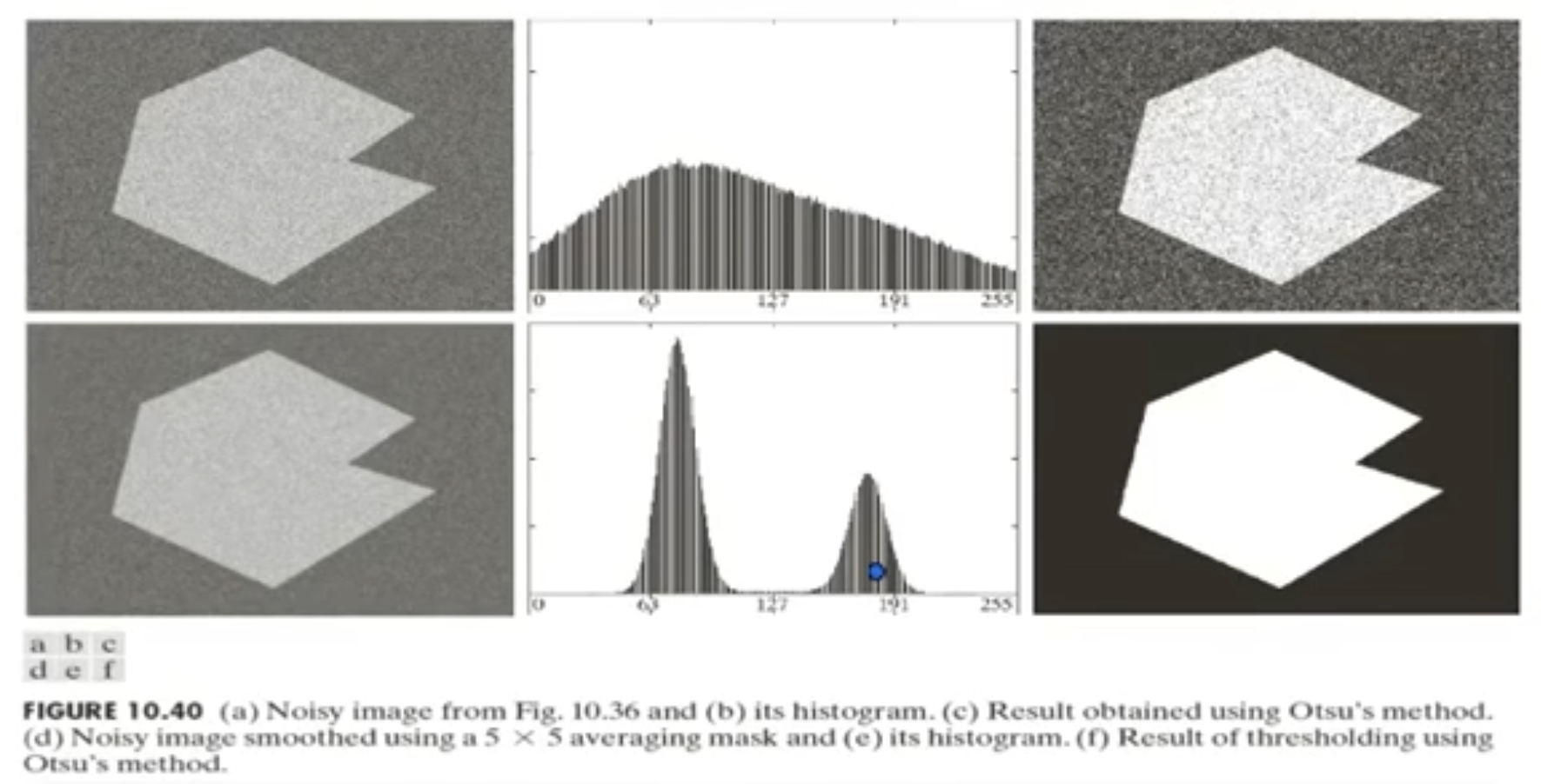
Filtering Before Thresholding?
[7]
Notes:
Topic of today is filter, denoising, thresh, particle counting etc

Slide 19
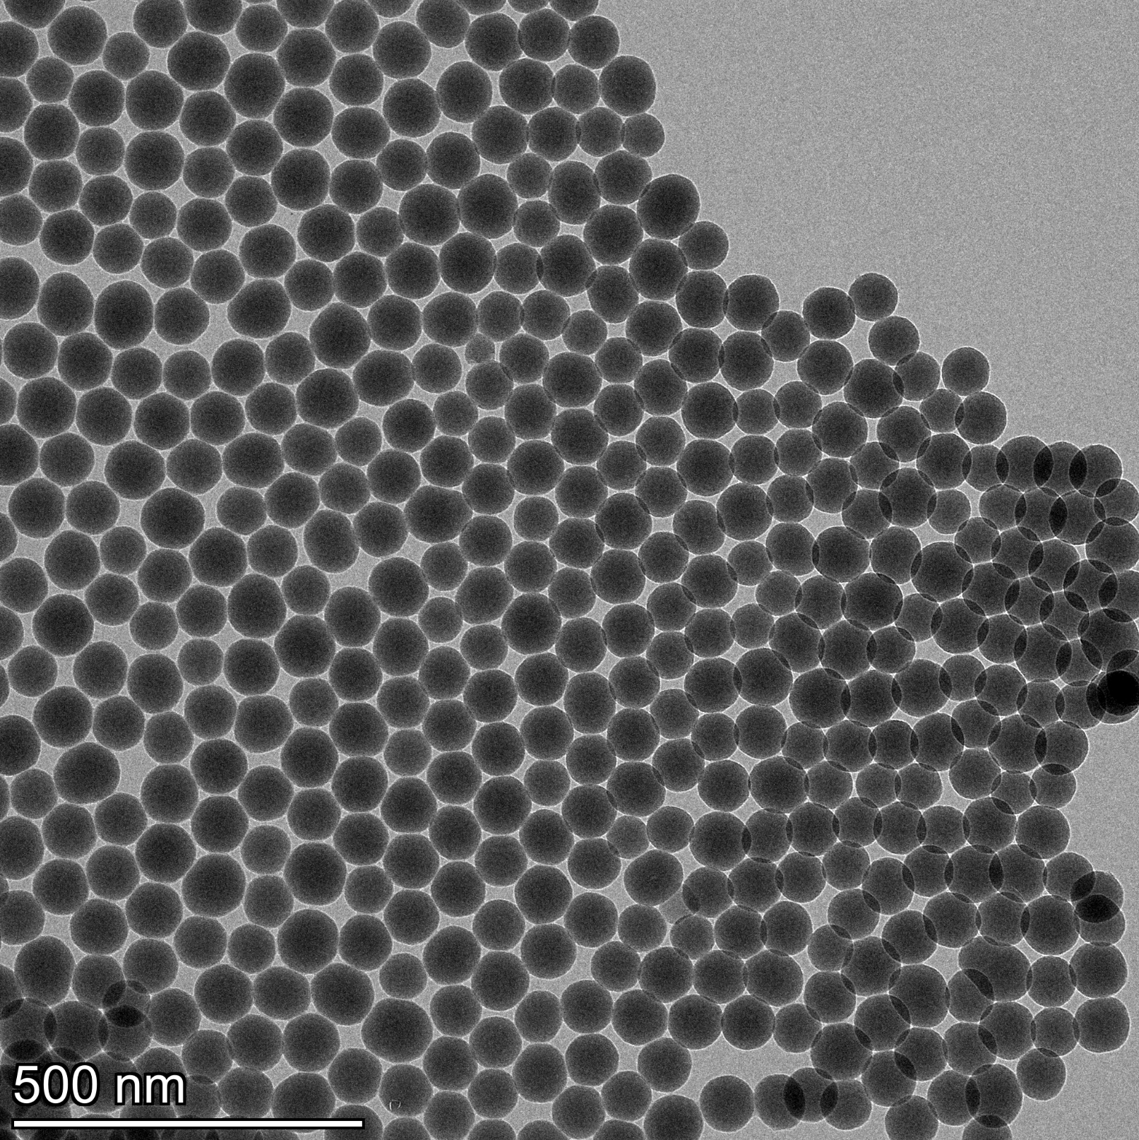
Tutorial
Using the image provided (0013_Ceta.tif), attempt to segment and count the cells/circles as best as possible.
Notes:
Topic of today is filter, denoising, thresh, particle counting etc

Slide 20
References & Additional Reading
[1] “Thresholding”, The Carpentries, https://datacarpentry.org/image-processing/07-thresholding/
[2] “Image Segmentation Using Thresholding”, Bhavin Gamit, Pratik Dave, Virang Patel, J.N. Sarvaiya, https://slideplayer.com/slide/13407919/
[3] N. Otsu, "A Threshold Selection Method from Gray-Level Histograms," in IEEE Transactions on Systems, Man, and Cybernetics, vol. 9, no. 1, pp. 62-66, Jan. 1979, doi: 10.1109/TSMC.1979.4310076. [4] Jui-Cheng Yen, Fu-Juay Chang and Shyang Chang, "A new criterion for automatic multilevel thresholding," in IEEE Transactions on Image Processing, vol. 4, no. 3, pp. 370-378, March 1995, doi: 10.1109/83.366472. [5] "Picture Thresholding Using an Iterative Selection Method," in IEEE Transactions on Systems, Man, and Cybernetics, vol. 8, no. 8, pp. 630-632, Aug. 1978, doi: 10.1109/TSMC.1978.4310039. [6] https://datahacker.rs/005-image-arithmetic-and-logical-operations-in-opencv-with-python/
[7] “Digital Image Processing – Third Edition”, by Rafael C. Gonzalez and Richard E. Woods, Pearson International Edition
[8] “Sobel filter” Wikipedia, Wikimedia foundation, 2022, February 22, https://en.wikipedia.org/w/index.php?title=Sobel_operator&oldid=1073238224
[9] “Detect Boundaries of Objects Within Video Using MATLAB Function Block on Android Device”, MathWorks,
https://www.mathworks.com/help/supportpkg/android/examples/detect-boundaries-objects-video-matlab-function-block-android.html
[11] “Auto Threshold”, ImageJ, https://imagej.net/plugins/auto-threshold
Notes:
Topic of today is filter, denoising, thresh, particle counting etc

Slide 21
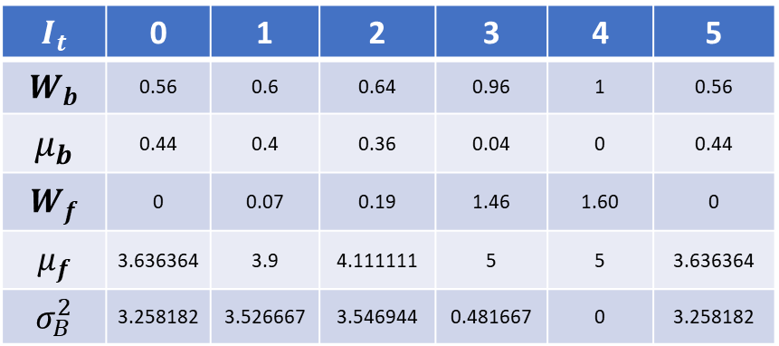
Otsu Thresholding
$$I_{t}$$ | 0 | 1 | 2 | 3 | 4 | 5
$$W_{b}$$ | 0.56 | 0.6 | 0.64 | 0.96 | 1 | 0.56
$$μ_{b}$$ | 0.44 | 0.4 | 0.36 | 0.04 | 0 | 0.44
$$W_{f}$$ | 0 | 0.07 | 0.19 | 1.46 | 1.60 | 0
$$μ_{f}$$ | 3.636364 | 3.9 | 4.111111 | 5 | 5 | 3.636364
$$σ_{B}^{2}$$ | 3.258182 | 3.526667 | 3.546944 | 0.481667 | 0 | 3.258182
0
0
0
0
0
0
4
4
4
0
0
4
5
4
0
0
4
4
4
0
0
0
0
0
0
Notes:
This means that in areas where the image has a constant intensity (i.e. where the intensity gradient is zero), the LoG response will be zero. In the vicinity of a change in intensity, however, the LoG response will be positive on the darker side, and negative on the lighter side

